Slide 1
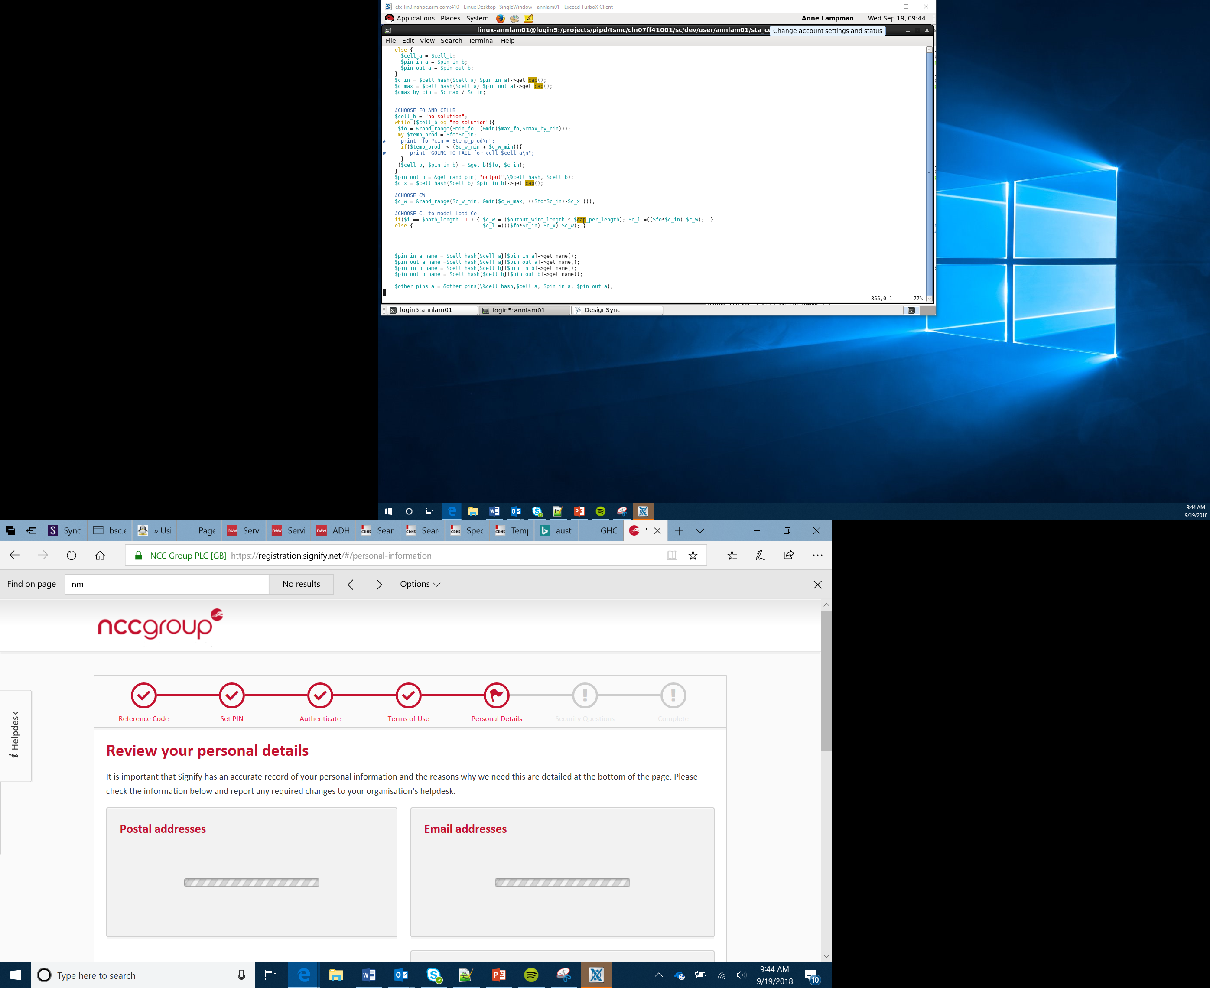

The Future of Technology
Lesson 14

Slide 2
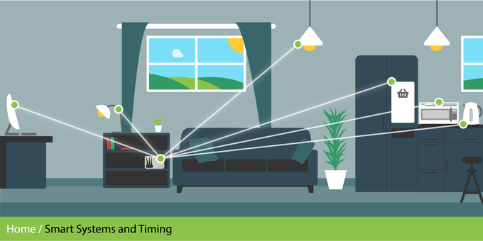
The Internet of Things
In the first unit we looked at the Internet of Things (IoT)
Adding electronics to everything
Electronics such as:
Sensors (for example, cameras, temp, light, humidity)
Microprocessors (like the micro:bit)
Everything can link to the internet/each other
Anything electronic can be controlled
Can stream data continuously
Notes:
This is a reminder about what the key characteristics of the IoT. It allows a wide range of household object to communicate with each other. They use sensors, microprocessors and screens. It allows all of the different items to link together and communicate with each other. You could give the example of a connected light bulb. This could be turned on and off from a mobile telephone. You could change the colour, brightness, set up timings all from the mobile phone.

Slide 3

Internet of Things – Smart Cities
As our population continues to increase cities are increasingly using technological solutions to solve a variety of problems
Notes:
Introduce the concept of smart cities. Cities are by their very nature highly populated areas which can cause a number of issues. The video introduces some technological ideas. If there is time it would also be worth exploring how Singapore has utilized technology.

Slide 4
Smart Cities Ideation
You should now think about the challenges that cities face
On the ideation worksheet make a note of these challenges
Choose one of the challenges and suggest how a technological solution may be able to solve it in the future
Notes:
Learners should think of all the challenges that cities face. This could be done individually or as part of a class discussion. Once Learners have noted a number of different challenges they should then choose one of these to try to think about how technology may be able to address it in the future.

Slide 5
E-Safety
As more and more IoT devices are developed, in addition to advantages they also bring with them a number of potential threats
If they are not secured hackers could access the devices and take over control
In a city this could be a major issue
What if someone took control of all of the traffic lights in a city or all of the street lamps? What issues could this cause?
On the IoT Challenges worksheet you should suggest what threats exist for a number of different devices
Notes:
This part of the lesson encourages Learners to think about potential threats that could be caused by connecting devices to the Internet. The worksheet asks them to think about traffic lights, street lamps and a power station.

Slide 6
Overcoming Potential Threats
When IoT devices are purchased they often have a default password. This should be changed immediately.
When communicating over the Internet rules should be followed that ensure that the data is encrypted. This means that it is encoded so if anyone intercepts it they will not understand the contents. The rules which state how data is communicated are called network protocols.
Devices should have up to date anti-malware software
The network should have a firewall which blocks malicious incoming and outgoing traffic
Notes:
Introduce the concepts of encryption and protocols. At this stage a deep understanding is not expected. Students should just be aware that encryption means that if data is intercepted it is meaningless without the necessary decryption key and that the rules which govern data communication are called protocols. Learners should then complete the matching terms worksheet.

Slide 7
Project Based Learning
Throughout this course you will be completing a number of projects where you will be able to develop new products
You will be working in teams of 4
Each person will have a different role
For each project you should undertake a different role within the team

Slide 8
The Four Team Roles
Project Manager:
Tasks being completed on time
Checking everything is complete
Storing the product and designs safely
Engineer:
Designing the product
Making the product
Testing the product
Developer:
Designing the IPO process
Programming the micro:bit
Testing the program
Marketing and communications:
Ensuring the team communicate
Creating the logo and branding the product
Writing the elevator pitch

Slide 9
Working in Parallel
Project Manager
Engineer
Marketing and communications:
Developer
Checking everything is going to plan and safely storing the work every lesson whilst also helping everyone
Designing the product
Making the product
Testing the product
Developing the logo
Branding the product
Writing the elevator pitch
IPO planning
Programming the micro:bit
Testing the program

